Slide 1
CMSC204
Kartchner
V(StateGraph) = {Oregon, Alaska, Texas, Hawaii, Vermont, NewYork, California}
E(StateGraph) = {(Alaska, Oregon), (Hawaii, Alaska), (Hawaii, Texas), (Texas, Hawaii), (Hawaii, California), (Hawaii, New York), (Texas, Vermont), (Vermont, California), (Vermont, Alaska)}
1. Draw the StateGraph
Alaska
New York
Oregon
Texas
Vermont
California
Hawaii

Slide 2
a. Show the adjacency matrix that would describe the edges in the graph. Store the vertices in alphabetical order
States
Alaska | California | Hawaii | New York | Oregon | Texas | Vermont
0 | 0 | 0 | 0 | 1 | 0 | 0
0 | 0 | 0 | 0 | 0 | 0 | 0
1 | 1 | 0 | 1 | 0 | 1 | 0
0 | 0 | 0 | 0 | 0 | 0 | 0
0 | 0 | 0 | 0 | 0 | 0 | 0
0 | 0 | 1 | 0 | 0 | 0 | 1
1 | 1 | 0 | 0 | 0 | 0 | 0
Alaska
California
Hawaii
New York
Oregon
Texas
Vermont
3. b. Show the adjacency lists
that would describe the edges in the graph
Alaska
Oregon
California
Hawaii
Alaska
California
New York
Texas
New York
Oregon
Texas
Vermont
Hawaii
Vermont
Alaska
California

Slide 3
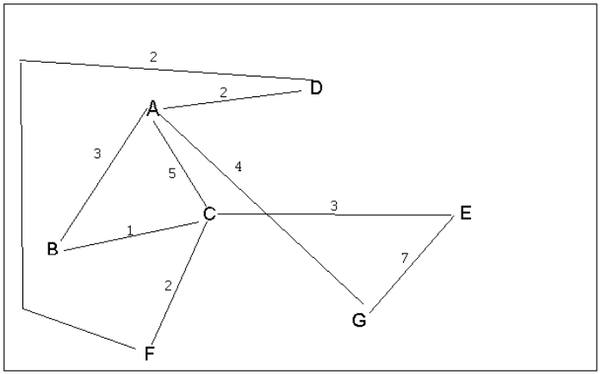
4 a. Which of the following lists the graph nodes in depth first order beginning with E?
A) E, G, F, C, D, B, A
B) G, A, E, C, B, F, D
C) E, G, A, D, F, C, B
D) E, C, F, B, A, D, G
4 b. Which of the following lists the graph nodes in breadth first order beginning at F?
A) F, C, D, A, B, E, G
B) F, D, C, A, B, C, G
C) F, C, D, B, G, A, E
D) a, b, and c are all breadth first traversals

Slide 4
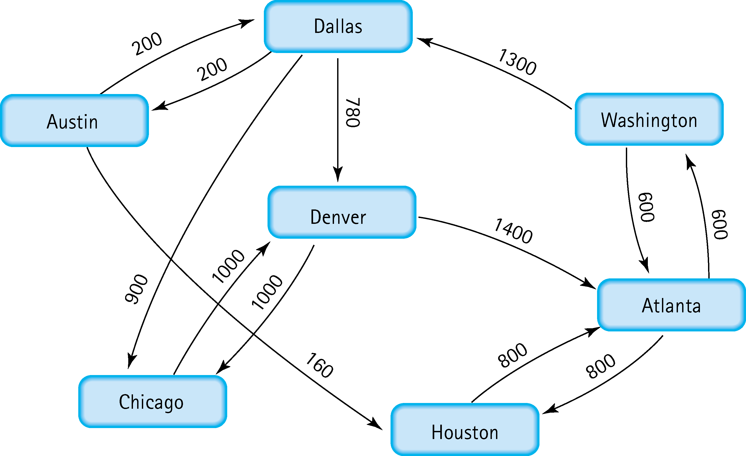
5. Find the shortest distance from Atlanta to every other city
Atlanta – Washington 600
Atlanta – Houston 800
Atlanta – Dallas 600+1300 = 1900
Atlanta – Denver 600+1300+780 = 2680
Atlanta – Austin 600+1300+200 = 2100
Atlanta – Chicago 600+1300+900 = 2800

Slide 5
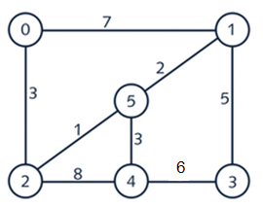
6. Find the minimal spanning tree using Prim’s algorithm. Use
0 as the source vertex . Show the steps.
Step 1:
Step 2:
Step 3:
0
0
0
1
5
5
2
2
2
Step 4:
Step 5:
0
1
0
1
5
5
2
4
2
4
3

Slide 6
7. Find the minimal spanning tree using Kruskal’s algorithm.
Show the weights in order and the steps.
Edge | Weight
2 – 5 | 1
1 – 5 | 2
0 – 2 | 3
4 – 5 | 3
1 – 3 | 5
3 – 4 | 6
0 – 1 | 7
2 – 4 | 8
0
1
Edge | Weight
2 – 5 | 1
1 – 5 | 2
0 – 2 | 3
4 – 5 | 3
1 – 3 | 5
3 – 4 | 6
0 – 1 | 7
2 – 4 | 8
5
V= {2,5}
2
4
3
0
1
Edge | Weight
2 – 5 | 1
1 – 5 | 2
0 – 2 | 3
4 – 5 | 3
1 – 3 | 5
3 – 4 | 6
0 – 1 | 7
2 – 4 | 8
5
V= {1,2,5}
2
4
3

Slide 7
0
1
Edge | Weight
2 – 5 | 1
1 – 5 | 2
0 – 2 | 3
4 – 5 | 3
1 – 3 | 5
3 – 4 | 6
0 – 1 | 7
2 – 4 | 8
5
V= {0,1,2,5}
2
4
3
0
1
Edge | Weight
2 – 5 | 1
1 – 5 | 2
0 – 2 | 3
4 – 5 | 3
1 – 3 | 5
3 – 4 | 6
0 – 1 | 7
2 – 4 | 8
5
V= {0,1,2,4,5}
2
4
3
0
1
Edge | Weight
2 – 5 | 1
1 – 5 | 2
0 – 2 | 3
4 – 5 | 3
1 – 3 | 5
3 – 4 | 6
0 – 1 | 7
2 – 4 | 8
5
V= {0,1,2,3,4,5}
2
4
3
0
1
Edge | Weight
2 – 5 | 1
1 – 5 | 2
0 – 2 | 3
4 – 5 | 3
1 – 3 | 5
3 – 4 | 6
0 – 1 | 7
2 – 4 | 8
5
V= {0,1,2,3,4,5}
2
4
3

Slide 8
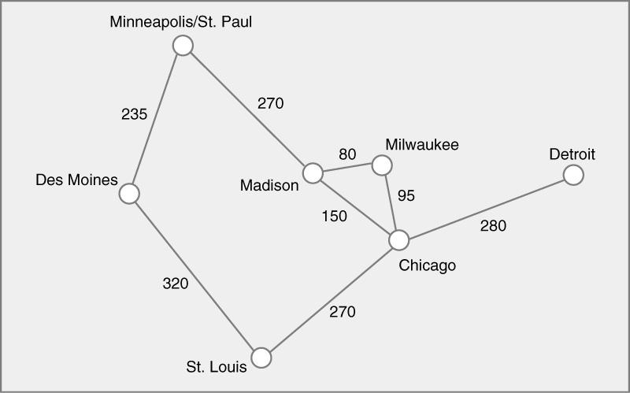
8. Find the minimal spanning tree using the algorithm you prefer. Use
Minneapolis/St. Paul as the source vertex

Slide 9
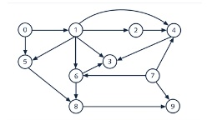
9. List the nodes of the graph in a breadth first topological ordering. Show the
steps using arrays predCount, topologicalOrder and a queue
[0] [1] [2] [3] [4] [5] [6] [7] [8] [9]
predCount
0 | 1 | 1 | 3 | 3 | 2 | 2 | 0 | 2 | 2
[0] [1] [2] [3] [4] [5] [6] [7] [8] [9]
topologicalOrder
queue
0 | 7
[0] [1] [2] [3] [4] [5] [6] [7] [8] [9]
predCount
0 | 0 | 1 | 3 | 3 | 1 | 2 | 0 | 2 | 2
[0] [1] [2] [3] [4] [5] [6] [7] [8] [9]
topologicalOrder
0
queue
7 | 1

Slide 10
[0] [1] [2] [3] [4] [5] [6] [7] [8] [9]
predCount
0 | 0 | 1 | 3 | 2 | 1 | 1 | 0 | 2 | 1
[0] [1] [2] [3] [4] [5] [6] [7] [8] [9]
topologicalOrder
0 | 7
queue
1
[0] [1] [2] [3] [4] [5] [6] [7] [8] [9]
predCount
0 | 0 | 0 | 2 | 1 | 0 | 0 | 0 | 2 | 1
[0] [1] [2] [3] [4] [5] [6] [7] [8] [9]
topologicalOrder
0 | 7 | 1
queue
2 | 5 | 6
[0] [1] [2] [3] [4] [5] [6] [7] [8] [9]
predCount
0 | 0 | 0 | 1 | 0 | 0 | 0 | 0 | 0 | 1
[0] [1] [2] [3] [4] [5] [6] [7] [8] [9]
topologicalOrder
0 | 7 | 1 | 2 | 5 | 6
queue
4 | 8
[0] [1] [2] [3] [4] [5] [6] [7] [8] [9]
predCount
0 | 0 | 0 | 0 | 0 | 0 | 0 | 0 | 0 | 0
[0] [1] [2] [3] [4] [5] [6] [7] [8] [9]
topologicalOrder
0 | 7 | 1 | 2 | 5 | 6 | 4 | 8
queue
3 | 9

Slide 11
Final Answer:
[0] [1] [2] [3] [4] [5] [6] [7] [8] [9]
predCount
0 | 0 | 0 | 0 | 0 | 0 | 0 | 0 | 0 | 0
[0] [1] [2] [3] [4] [5] [6] [7] [8] [9]
topologicalOrder
0 | 7 | 1 | 2 | 5 | 6 | 4 | 8 | 3 | 9
queue

Slide 12

10. List the nodes of the graph in a breadth first topological ordering.
Start
Discrete Math
Programming 1
Computer Organization
Programming 2
Operating Systems
Algorithms
High-Level Languages
Compilers
Theory of Computation
Senior Seminar
End

